Slide 1
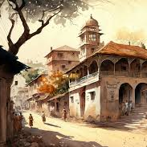
The Village of Palampur
Key Economic Concepts
By Nishanth M H
9th Grade Economics

Slide 2
Introduction to Palampur
Hypothetical village to explain rural economic activities.
Located close to a well-connected road to neighboring villages and towns.
Population of about 450 families belonging to different castes.

Slide 3
Geography and Demographics
Geographical setting and layout.
Demographic details: Population diversity, caste composition.
Climate and natural resources.

Slide 4
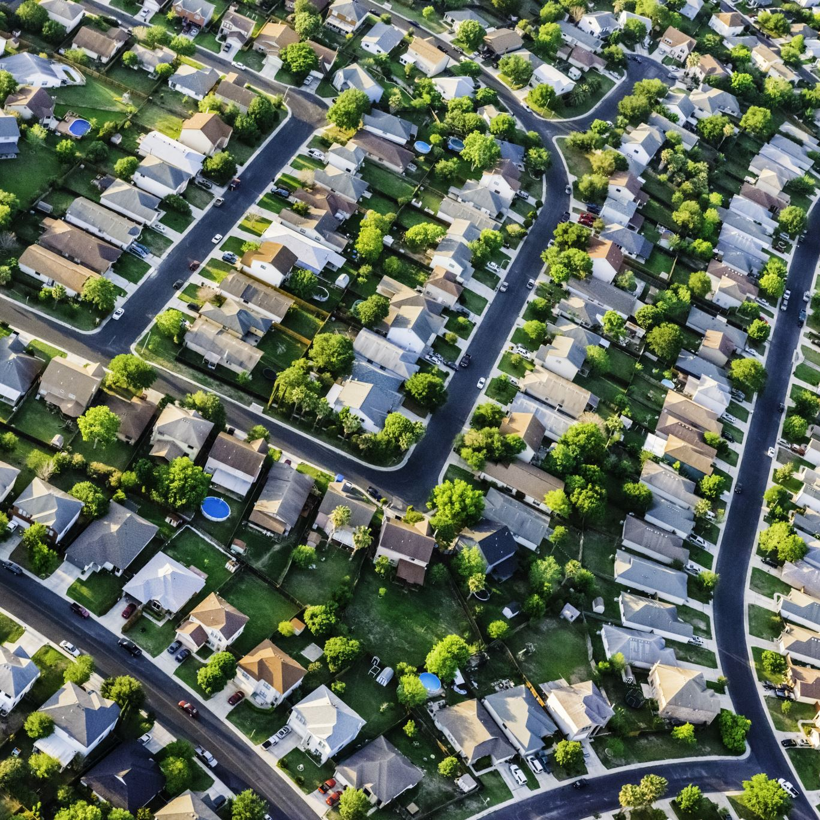
Infrastructure
Roads: Well-connected roads to other villages and towns.
Electricity: Nearly all houses have electric connections.
Education: One primary school and one high school.
Healthcare: Primary health center and a dispensary.

Slide 5

Agriculture: The Main Activity
Primary economic activity.
Importance of agriculture for livelihood.
Different crops grown in the village.

